Slide 1
SMART ASSIST
Varshini R
Shreya MN
Sai Varshini
Anshula Ranjit

Slide 2
PROBLEM STATEMENT
Individuals suffering from Neuromuscular disabilities such as ALS, Muscular Dystrophy, Parkinson's, etc. require the aid of the wheelchair that focuses on providing support for their basic day-to-day activities that majorly includes the mobility.
This project focuses on building an automated wheelchair based on the individual’s pupil movement.
The eye muscle is that part of the human anatomy that is least affected during the attack of paralysis.

Slide 3
LITERATURE STUDY
Wheelchair Control Using An Eye Tracking System For Assisted Mobility- Srimathi. P,Kanthini. B, Kaushik Kumar Sen. Electronics and Communications Engineering, SRM University, Vadapalani.
A Prototype of Electric Wheelchair Controlled by Eye-Only for Paralyzed User- Kohei Arai, Ronny Mardiyanto, Saga University.
Iris Controlled Wheel Chair in Real Time- Kshama Chaudary, Naveen Agarwal, Naveen Garg, Vikas Deep, Department of Information Technology, Amity University.
Iris movement based wheelchair control using raspberry pi- school of electronic engineering VIT university, Vellore
Automatic Camera Based Eye Controlled Wheelchair System Using Raspberry Pi, International Journal of Science, Engineering and Technology Research (IJSETR), Volume 5, Issue 1, January 2016

Slide 4
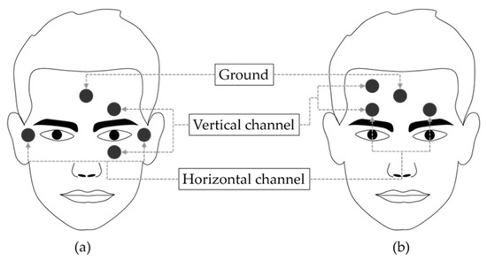
EXISTING MODELS
1. In Electro-Oculogram method
Electrooculography (EOG) is a technique for measuring the corneo-retinal standing potential that exists between the front and the back of the human eye
There can be electrode slippage
Very large eye movements cannot be detected with accuracy.
The detected signals can be easily contaminated.

Slide 5
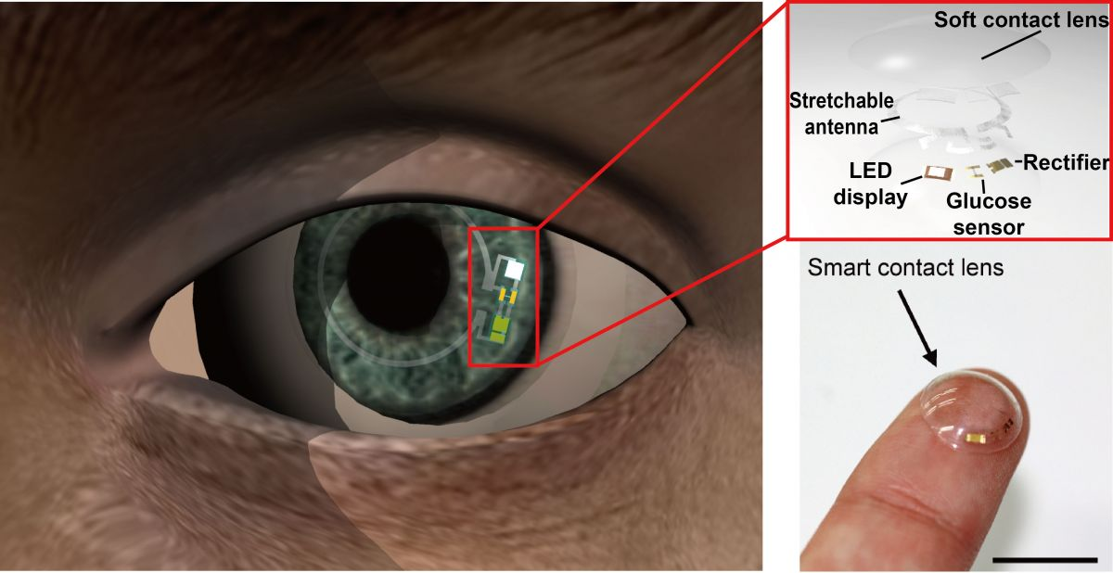
2. In lens tracking system
In this method a non slipping contact lens fits over corneal bulge. The tracking of the pupil is recorded by affixing a magnetic coil or mirror to the lens. The integrated mirror in the contact lens allows measuring reflected light.
A slight mishap in the placing of the lens on the corneal bulge can cause damage to the eye.
This method is obtrusive and are not suited well for interaction by gaze.

Slide 6
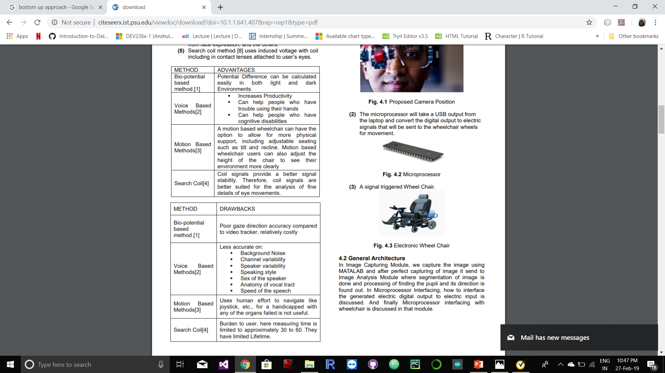
SOME MORE MODELS
The existing computer input devices can be divided into five categories:

Slide 7
OUR PROPOSAL/IDEA
Maneuvering of the wheelchair with the assistance of eye movements. In this method, the eye movements are captured by the IP Camera App and the image of the eye is stored and the position of the eye pupil is tracked using image processing technique.
According to the eye pupil position of the user, motor will be moved in the required direction. Ultrasonic sensors are used to detect obstacles that may be static or mobile in nature and the wheelchair is stopped automatically for safety purposes. A raspberry pi board is used as the control system. Bluetooth module is used for connectivity reasons of Arduino Uno and movements through the eye pupil.
Notes:
The users can communicate with the smart home automation for switching on lights and fans depending on the climatic conditions such as humidity, light intensity, temperature, etc
They can even send distress messages to their handlers who are in charge of their care.

Slide 8
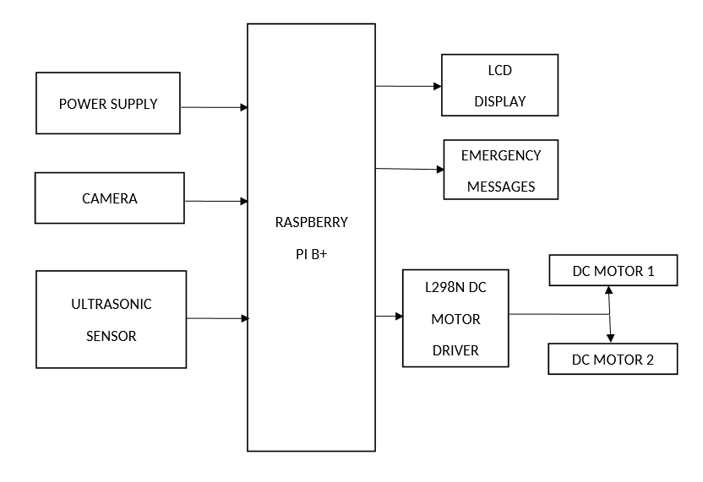
ARCHITECTURE

Slide 9
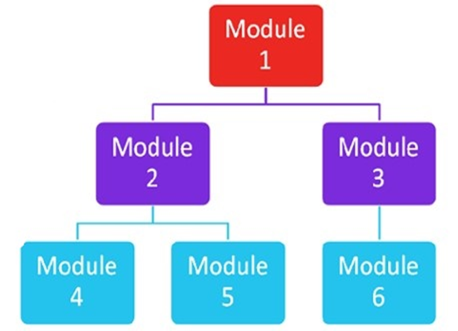
MODULES OF THE PROJECT

Slide 10

IMAGE CAPTURING MODULE
Image Capturing is to capture a sequence of iris images from the subject using a specially designed camera. In iris recognition image capturing is a very important step. Since iris is small in size and dark in color, it is difficult to acquire good image. The image is then changed from RGB to gray level for further processing. It is to capture a sequence of iris images from the subject using a specifically arranged camera. With an average diameter of 12 mm, a camera must have enough resolution to capture the details of the iris pattern.

Slide 11
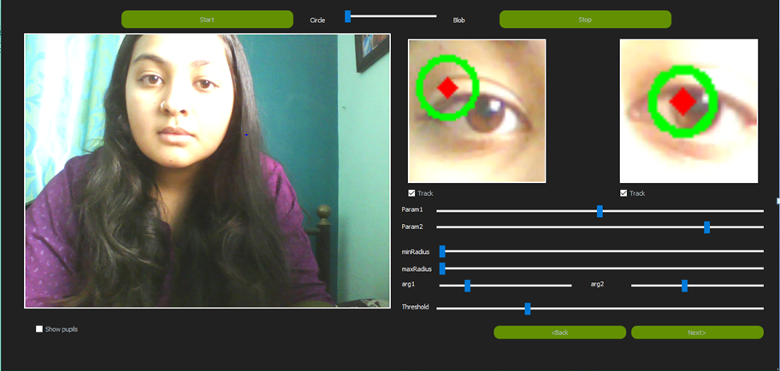
IMAGE PROCESSING MODULE
The main objective of segmentation is to remove non useful information, namely the pupil segment and the part outside the iris (sclera, eyelids, skin).

Slide 12
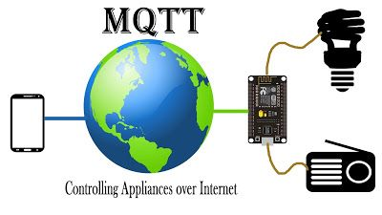
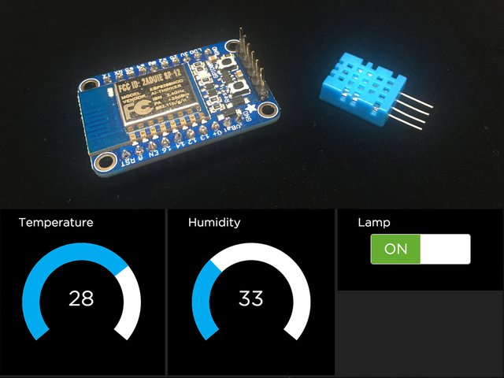
HOME AUTOMATION MODULE
A home automation system will control lighting, entertainment systems, and appliances. When connected with the Internet, home devices are an important constituent of the Internet of Things.
We are using Ultrasonic sensors for detection of the bot when it enters the room and the lamp switches on.

Slide 13
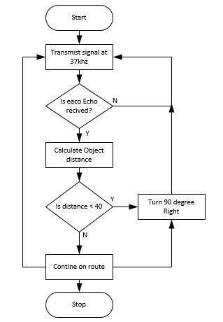
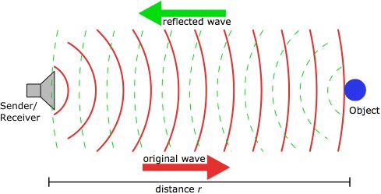
DETECTION OF OBSTACLES
This will be done by using Ultrasonic Concept.
The ultrasonic sensors sends out the waves when it comes across any obstacle(living and non-living).
These waves will be reflected from the obstacles and the obstacle shall be detected.
The data from the ultrasonic sensors will be managed by the Arduino present on the bot.

Slide 14
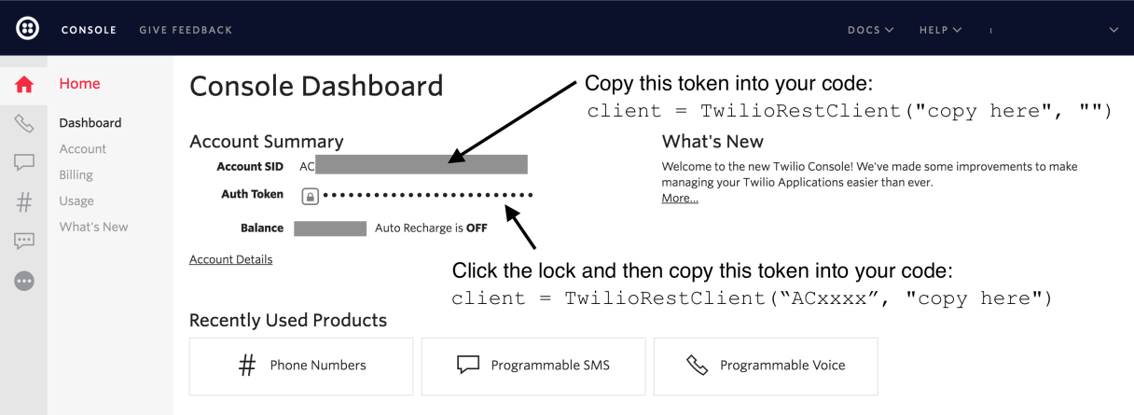
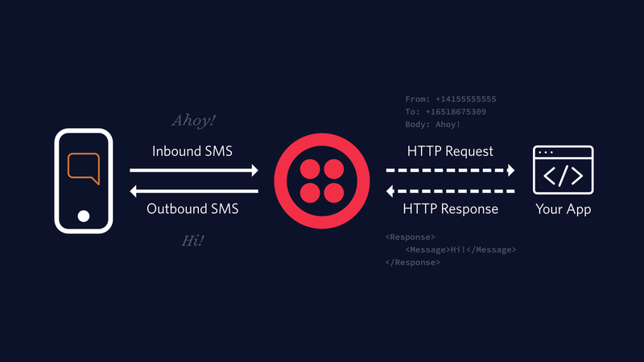
DISTRESS MESSAGE MODULE
This mechanism is to send out emergency messages to the person in charge of being a care taker to the physically handicapped individuals,
This done by sending a message directly to that person.
Our simple Python example application will use the Twilio web API to send picture messages. Go to the Twilio website sign up for a free trial account. If you already have a Twilio account (and you should because it makes it easy to add almost any type of communications to applications!) then sign into your existing account. Twilio can send MMS to a validated phone number associated with the account.

Slide 15
HARDWARE COMPONENTS
Arduino Uno
HC-05 Bluetooth
ESP8266 WiFi Module
Raspberry Pi3 B+
Camera dependable device
BOT

Slide 16
SOFTWARE COMPONENTS
Python IDE
Arduino Uno
Anaconda
Raspbian Thonny

Slide 17
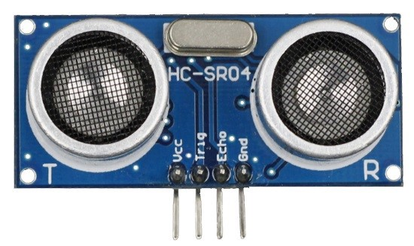
ULTRASONIC SENSOR PIN CONFIGURATION
Pin Number umber | Pin Name | Description
1 | Vcc | The Vcc pin powers the sensor, typically with +5V
2 | Trigger | Trigger pin is an Input pin. This pin has to be kept high for 10us to initialize measurement by sending US wave.
3 | Echo | Echo pin is an Output pin. This pin goes high for a period of time which will be equal to the time taken for the US wave to return back to the sensor.
4 | Ground | This pin is connected to the Ground of the system.

Slide 18
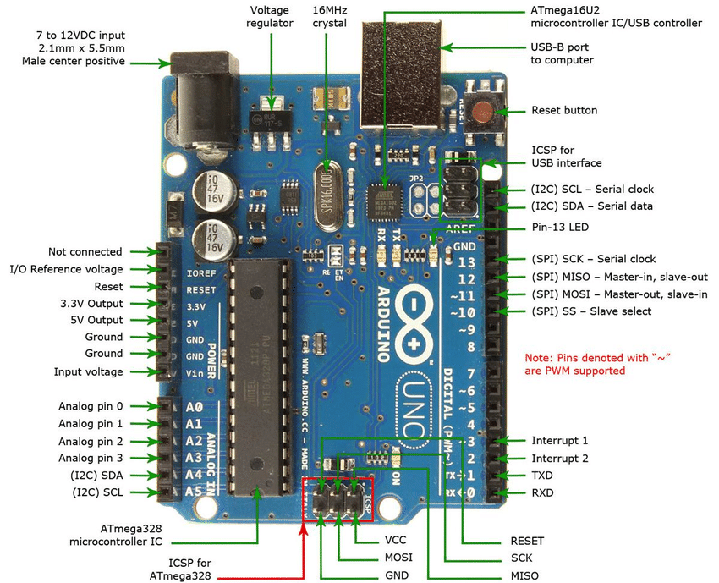
ARDUNIO UNO PIN CONFIGURATION

Slide 19
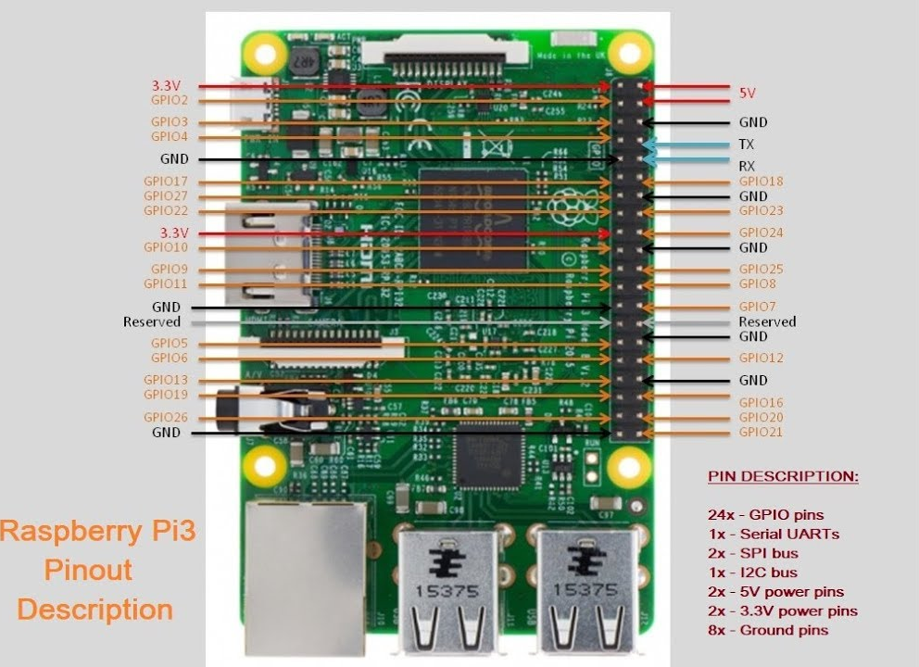
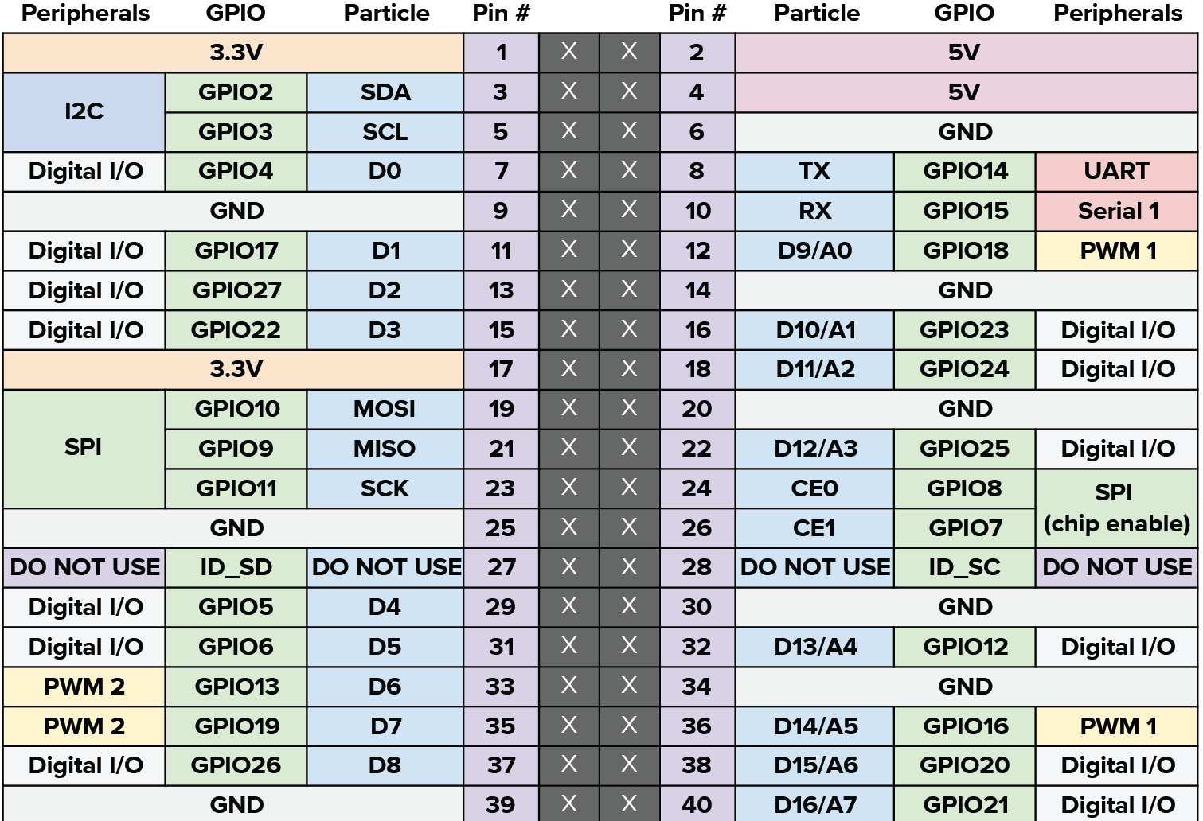
RASPBERRY PI 3 PIN CONFIGURATION

Slide 20
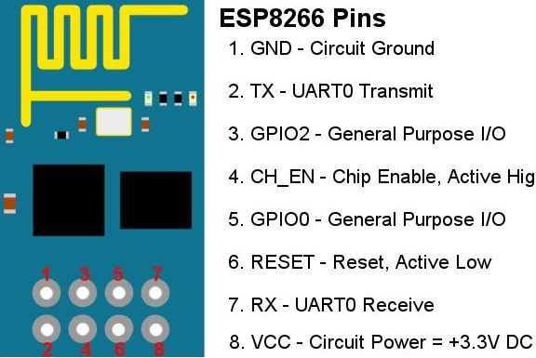
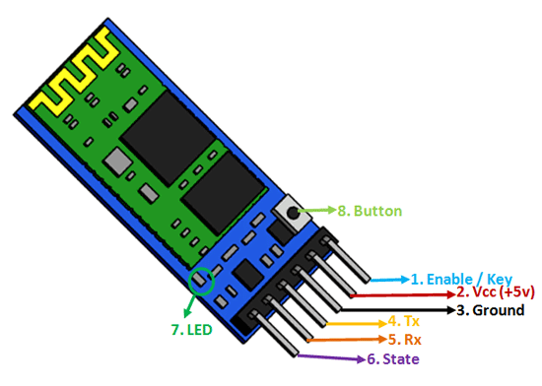
WIFI & BLUETOOTH PIN CONFIGURATION

Slide 21
ADVANTAGES
The proposed model is the advancement of the manually operated wheelchair and the existing automated ones.
This project overcomes the drawbacks of the above mentioned methods that are being used currently.
Previous designs were referenced to improve current design.
Our system uses the eyeball sensor which tracks the position of the eye by using a simple application IP CAM which make the wheelchair safer for the patient.
Hardware component reduction.
Simpler and hence easier to implement.
Cost efficient.

Slide 22
FUTURE ENHANCEMENTS
Include home security such as access control and alarm systems.
The delay between the blinks can be made more accurate than the present.
Control appliances without any hinderence.
Integrate both pupil control and other senses into one single automated wheelchair.
Accustom to maneuver during night (absence of light).
Build a chatbot for communication and entertainment purpose.

Slide 23

Home Automation

Slide 24
BOT Movements

Slide 25
THANK YOU!

